Slide 1
Excel Lab
Box Plot
Side-by-side Box Plots
Descriptive Statistics
Five Number Summary
Dr. Abolfazl Saghafi
Assistant Professor of Statistics & Data Science
Data Science Program Director
Notes:
It’s best to print these slides, add your notes, and use it as a guide when taking the excel project test

Slide 2

Download BrainCancer Dataset from Project Folder on D2L.
1. Generate a Frequency table and a proper chart for Variable Sex. Table and chart should have labels (Female, Male) instead of (0, 1)
You have 3 minutes!
2. Generate a Grouped Frequency table with 11 categories and a histogram (11 bars) for Variable Tumor Size. The chart should have proper title and axis labels and frequency counts on top of the bars.
You have 4 minutes!
3. Generate a Cross-table and grouped bar chart for variables Sex and Marital Status.
You have 2 minutes!
Notes:
Show me what you got!
To sort on Mac
Select ALL the data and variables, Go to menu “Data”, Select “Sort”, Checkbox “My list has headers”, In the row next to Sort by, under Column, click the blank space, and then click the column that you want to sort by, Hit OK.
For variable marital status, the codes represent 1=single, 2=married, 3=divorced

Slide 3
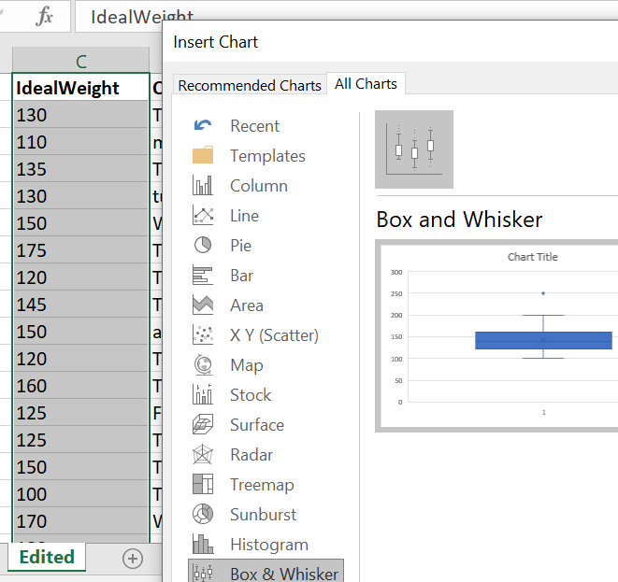
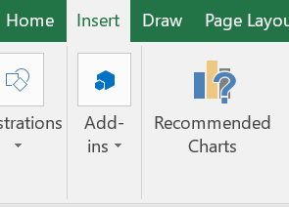
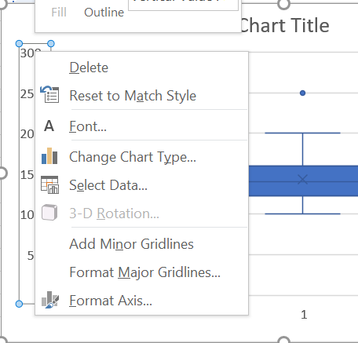
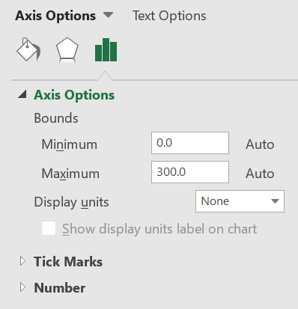
To graph a Box plot, select the variable and its data entries (“Ideal Weight” here)
Go to Menu Insert
Select Recommended Charts
Go to Tab All Charts
Select Box & Whisker
Hit OK
You have the chart
Add axis labels, edit title
Right click on the y-axis values and select Format Axis
On the new window change Minimum and Maximum so that you have a good zoomed view
Edit Color/Gridlines/…
Notes:
IF you don’t have a box plot option in your All Charts, you need to upgrade your excel. MS 365 is available for free to USciences students, google IT Office 365 USciences and follow instructions to upgrade your excel.

Slide 4
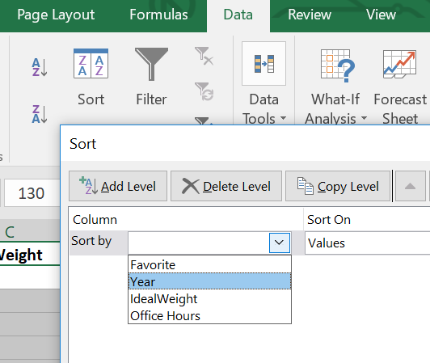
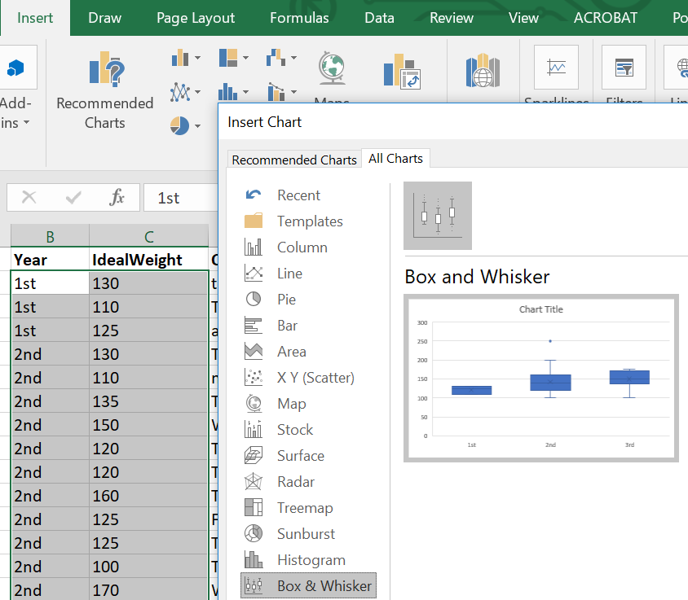
For Side-by-side Box plots, Go to Menu Data
Select Sort
Sort by Year (or your categorical variable) and Hit OK
Categorical variable should be on the left
Select the two Columns of Year and Ideal Weight data
Go to Menu Insert
Select Recommended Charts
Go to Tab All Charts
Select Box & Whisker
Hit OK
Edit the Chart appropriately just like
the previous slide
Notes:
Three important points here
1. You need to sort all your data based on your categorical variable first
2. If your categorical variable is coded (1, 2, …), you need to change the codes to their labels, like male, female, …
3. Your categorical variable should be on the left of your continuous variable for the graph to be plotted correctly
4. Select the qualitative and quantitative variables’ names and data entries and go to …

Slide 5
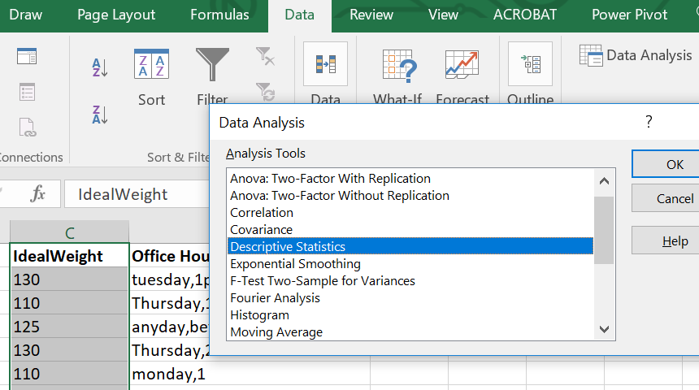
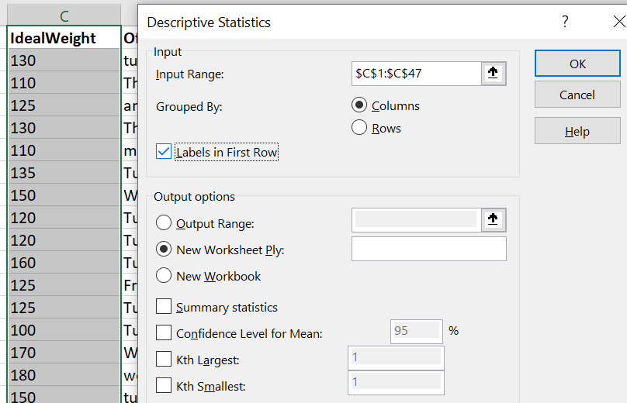
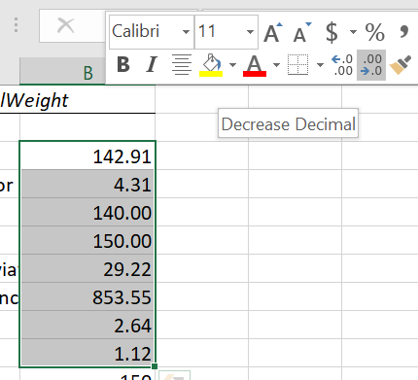
To have Descriptive Statistics summary
Go to Menu Data
Select Data Analysis
Select Descriptive Statistics
Hit OK
Select the box in front of Input Range, then select the quantitative data values
Check mark Labels in First Row, IF you are selecting the variable label as well
Check Summary Statistics
Hit OK
Change the decimal place to two by right clicking and using the tool shown in the photo
Notes:
For Windows, if the Data Analysis is not in the Data menu, Go to File, Options, Add-ins, Select Analysis Toolpack and Analysis Toolpack – VBA and hit GO. Checkmark them booth in the new window and they should pop up in your Data menu.
For Mac users, Go to the Tools menu, select "Add-ins“, Check "Analysis ToolPak" then click OK. Select the "Data" tab, then select ""Data Analysis“ to access the same Descriptive Summary tool.

Slide 6
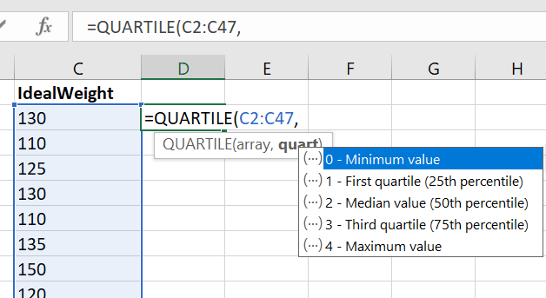
To compute the Five Number Summary
On an empty cell Type
=QUARTILE(
Select ONLY your data values
Type ,
Now, for minimum type 0
for first quartile type 1
for median type 2
for third quartile type 3
for maximum type 4
Close parenthesis and Press Enter

Slide 7
Practice Lab
Read Project Phase 1 Descriptions and practice with two provided Plain excel files to be prepared for the excel project.
You can also practice with Brain Cancer dataset.
1. Generate a box plot for variable Age at Diagnosis.
2. Generate a side-by-side box plot for variables Sex and Age at Diagnosis.
3. Generate descriptive statistics for Age at Diagnosis separately for Female and Male patients.
4. Generate five-number summaries for Age at Diagnosis separately for Female and Male patients.
Notes:
There are Practice Datasets in the Project folder
Do practice as this a VERY important skill

